Slide 1
Code Optimization and Best Practices
Trimols 11/18/2023
Andrew Smith
Duke – Beratan Lab

Slide 2
683,132,174

Slide 3
Overview
This is meant to be an advanced python workshop
We will discuss methods for optimizing and managing code.
This is a very high level overview. I have included additional resources and examples at the end.
Python review
Code optimizing
SnakeViz
Trace
Other optimization strategies in brief
Performance optimization
CPU parallelization with MPI
Best Practices
Docstrings
Git
Commandline args
OOP
Example codes:
https://github.com/ajsmit24/TrimolsPresF2023

Slide 4
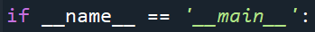
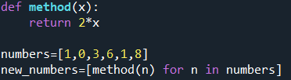
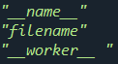
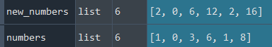
Python Review
The special variable __name__
List comprehension

Slide 5
So you want to optimize your code?
In order to optimize one must first identify problems
2 main types of issues: time and space complexity
Time complexity
Things take too long.
Hard to diagnose a priori, especially in large projects.
Profiling is your friend.
SnakeViz is your neighborhood friendly profiling helper
Space complexity
Things are too big.
When one runs out of RAM using hard disk memory can take 100x longer.
Maybe diagnosable a priori
Example tool for those interested
https://github.com/zhuyifei1999/guppy3/

Slide 6
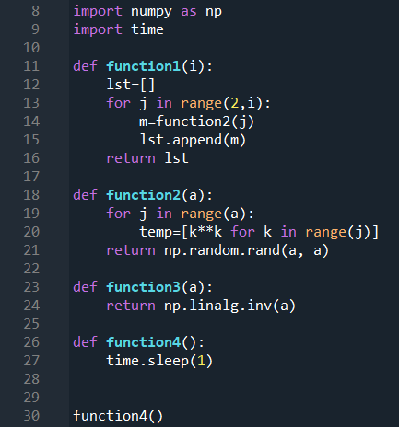
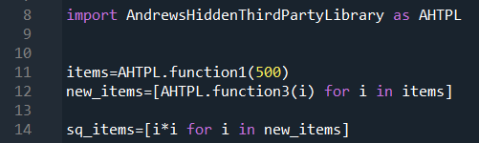
How long does this take?

Slide 7
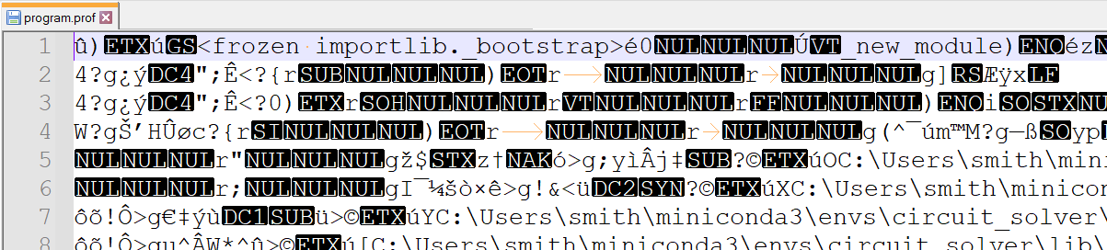
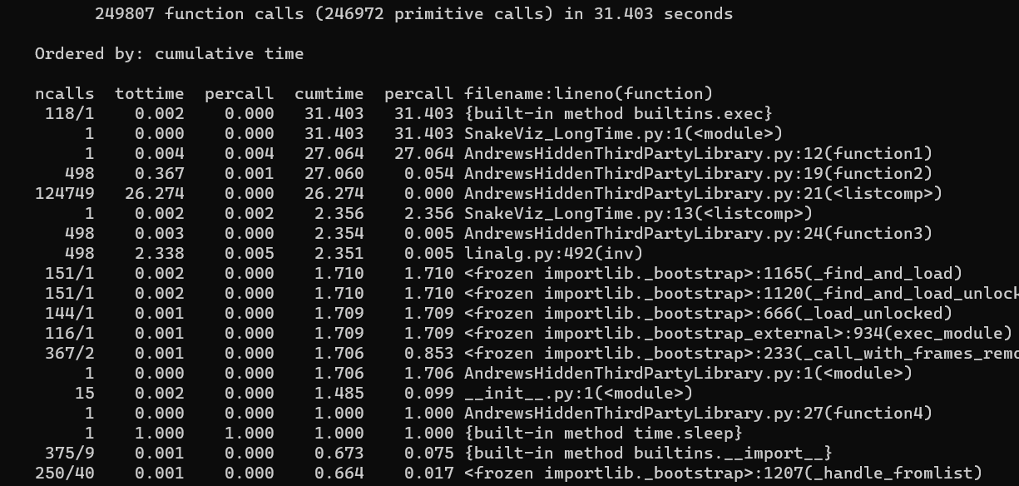
How long does this take?
python -m cProfile -o program.prof SnakeViz_LongTime.py

Slide 8
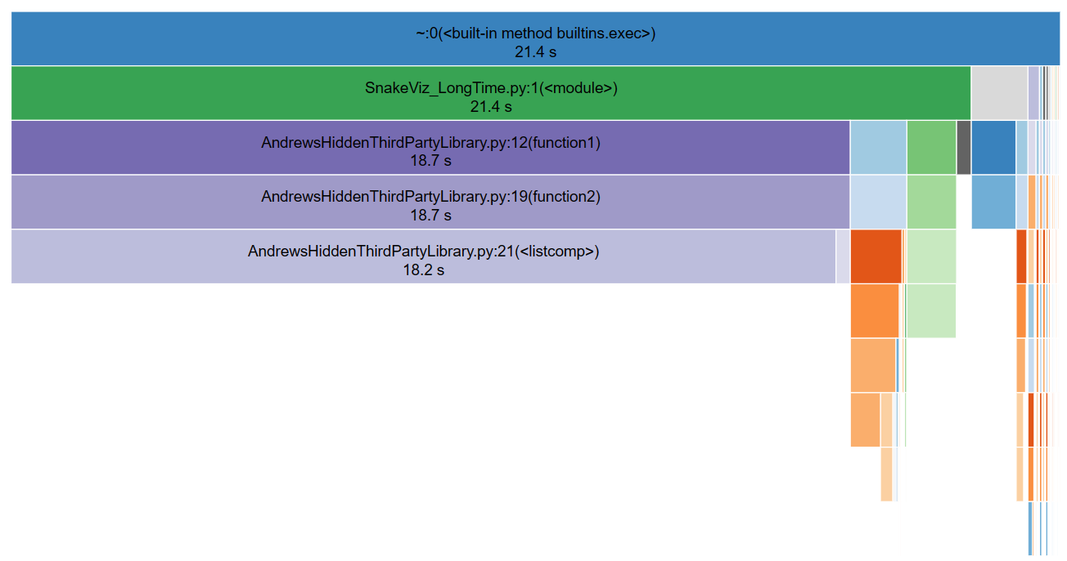
How long does this take?

Slide 9
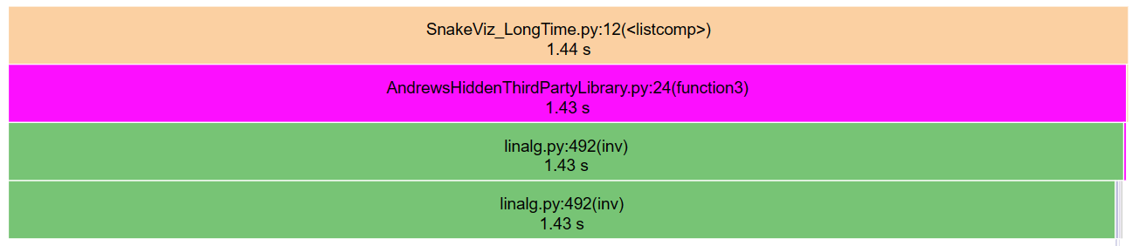
How long does this take?

Slide 10
Other Optimization Strategies
Matrices
Numpy – better memory management faster lists
Scipy – Many things but notably faster matrix math in some cases
PyTables - save matrix to file and read/do math piecewise – key for extremely large matrices
[0,0,0,0,0,2,1]
[0,0,0,4,0,0,0]
[0,0,3,2,1,6,3]
[0,0,4,5,0,0,0]
[1,8,2,7,0,0,0]
[0,0,0,0,0,0,0]
[1,3,4,5,0,0,0]

Slide 11
Other Optimization Strategies
Matrices
Numpy – better memory management faster lists
Scipy – Many things but notably faster matrix math in some cases
PyTables - save matrix to file and read/do math piecewise – key for extremely large matrices
[0,0,0,0,0,2,1]
[0,0,0,4,0,0,0]
[0,0,3,2,1,6,3]
[0,0,4,5,0,0,0]
[1,8,2,7,0,0,0]
[0,0,0,0,0,0,0]
[1,3,4,5,0,0,0]

Slide 12
Other Optimization Strategies
Matrices
Numpy – better memory management faster lists
Scipy – Many things but notably faster matrix math in some cases
PyTables - save matrix to file and read/do math piecewise – key for extremely large matrices
[++++------2,1]
[++++0,4,-----]
[++++3,2,1,6,3]
[++++4,5,+++++]
[1,8,2,7,+++++]
[--------+++++]
[1,3,4,5,+++++]
Further reading/Examples
Numpy – https://numpy.org/doc/1.26/user/index.html#user
Scipy – https://docs.scipy.org/doc/scipy/reference/sparse.html
PyTables - https://medium.com/@ph_singer/handling-huge-matrices-in-python-dff4e31d4417

Slide 13
Other Optimization Strategies
Do less math
Memorization – don’t repeat intermediate calculations
https://www.youtube.com/watch?v=qORqpMg3Uew
pruning – certain cases are trivial and can be ignored

Slide 14
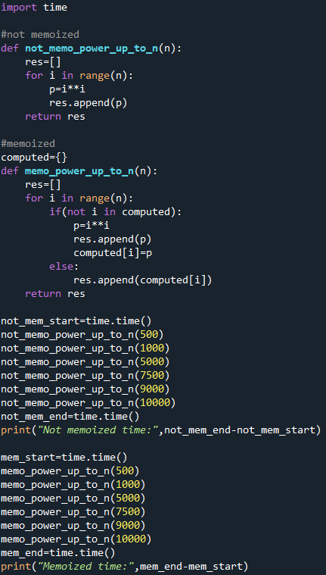
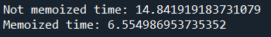
Other Optimization Strategies
memoizatio

Slide 15
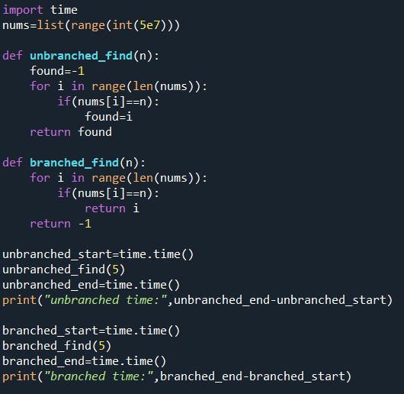
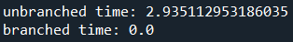
Other Optimization Strategies
pruning

Slide 16
Other Optimization Strategies
Parallelize
Numba – automatically detects parallelizable code
Sometimes the auto detection messes up
If the code cant be parallelized there will be a small net slow down
MPI4PY – running code in parallel across many CPUs
Further reading/Examples
Numba – this is really all you need to start -https://numba.pydata.org/numba-doc/latest/user/5minguide.html
MPI4PY – we will do some examples but the official docs has some great ones too - https://mpi4py.readthedocs.io/en/stable/tutorial.html

Slide 17
MPI

Slide 18
MPI
Normal Series Programming
Head
Submit job
Compute node
Do calculation
result
result
result

Slide 19
MPI
CPU Parallelized
Head
Compute Node with controller CPU
Worker CPU
Worker CPU
Worker CPU
result
result
result

Slide 20
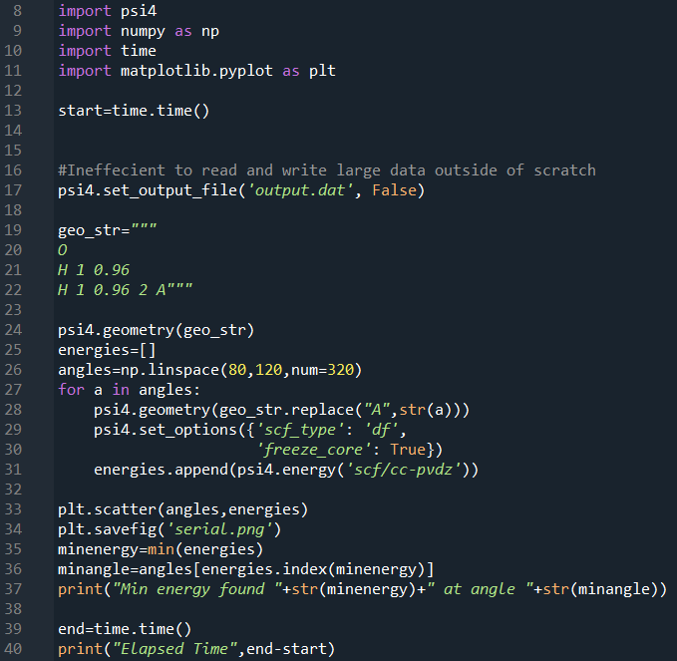
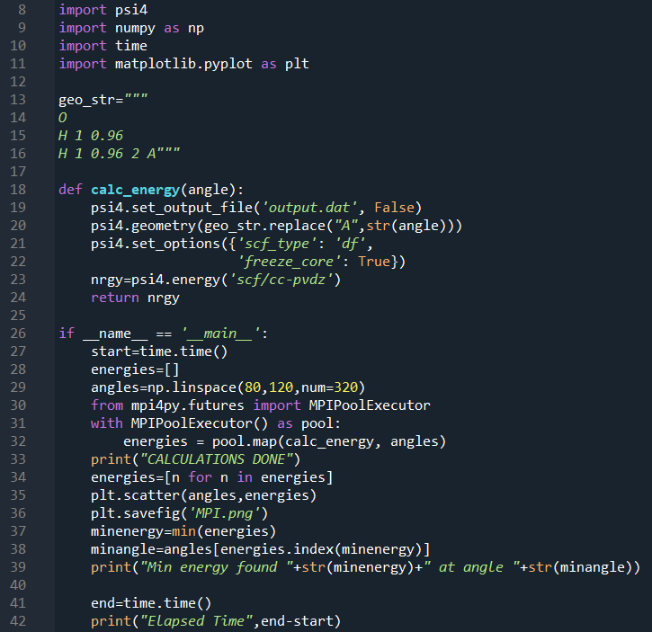
MPI

Slide 21
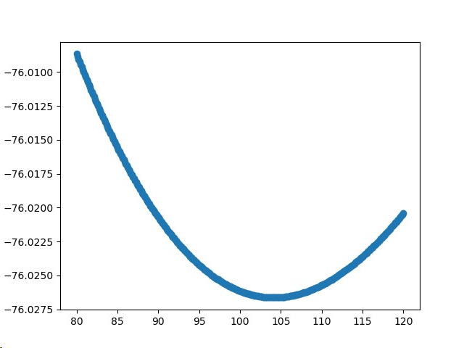
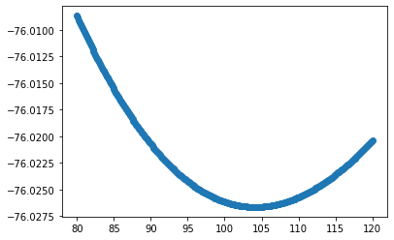
MPI

Slide 22
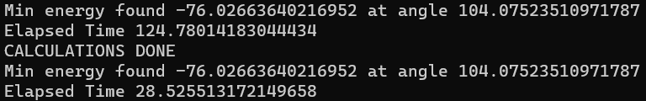
MPI

Slide 23
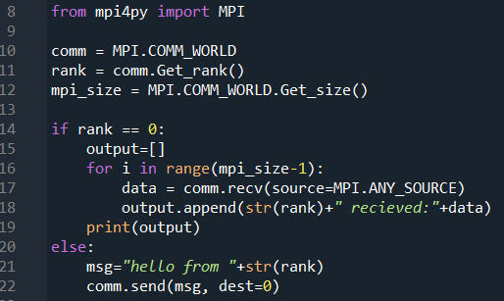
MPI

Slide 24
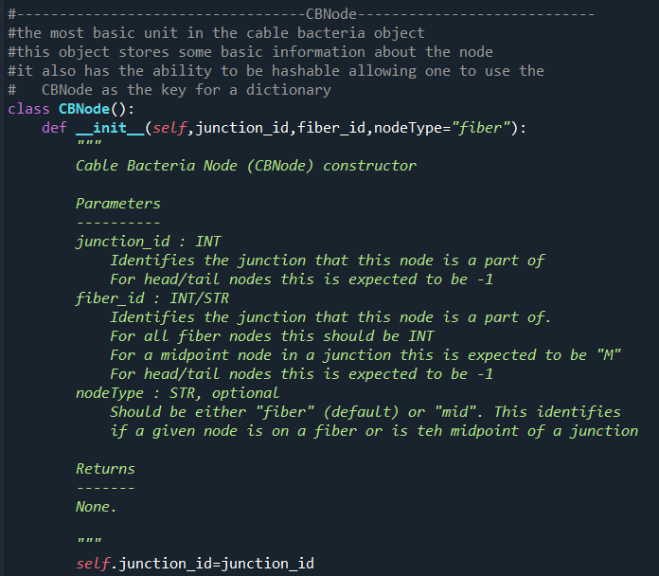
Best Practices
Docstrings

Slide 25
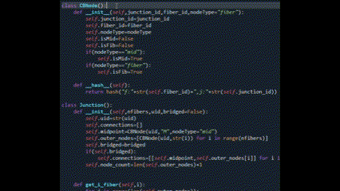
Best Practices
Docstrings

Slide 26
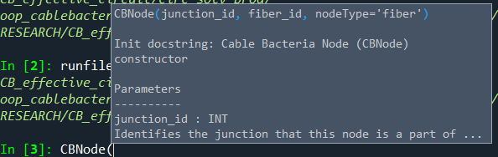
Best Practices
Docstrings

Slide 27
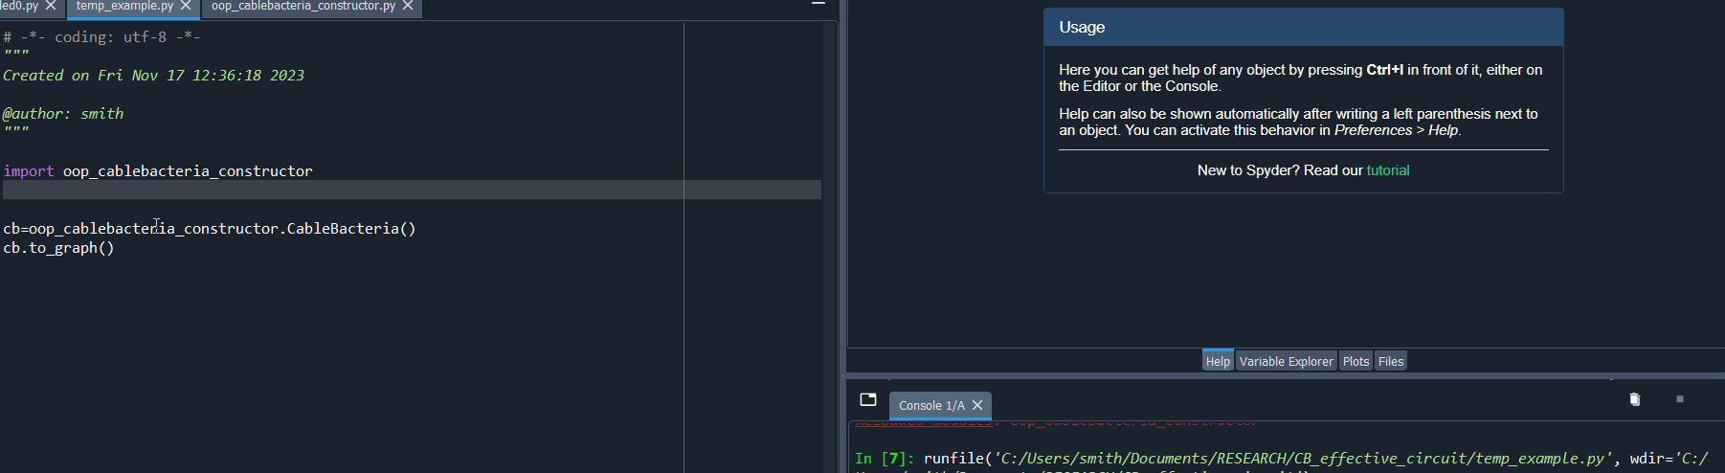
Best Practices
Docstrings

Slide 28

Best Practices
Version control

Slide 29
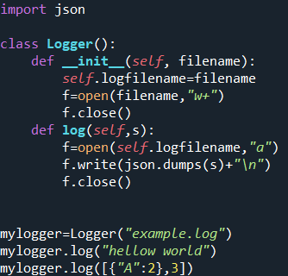
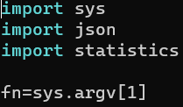
Best Practices
Programming Design Frameworks
Object oriented
Unix Style

Slide 30
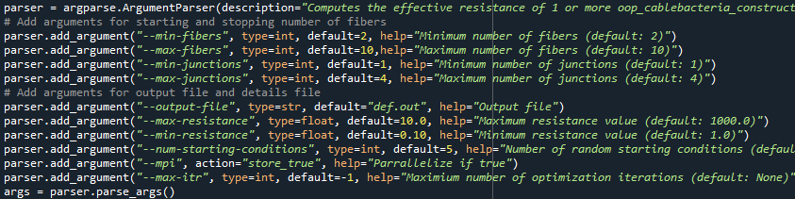
Best Practices
Programming Design Frameworks
Command line arguments

Slide 31
Code Availability
Most of the code in this presentation and the slides are available on github
Some of the code screenshots are from my research. These are not included on the github as they are too complex to be useful examples beyond the screenshot.
https://github.com/ajsmit24/TrimolsPresF2023

Slide 32
Tutorial Description
This presentation provides a high level overview of techniques for optimizing python code and running code in parallel.
At a cursory level will we cover the following libraries: numpy, scipy, trace, pytables, numba
In detail we will cover: SnakeViz, MPI4PY
In detail we will cover the concept of CPU parallelization with MPI

Slide 33
Instructions and setup:
Expectations
This presentation is an advanced python workshop/lecture. You do not need to be an expert programmer but you need to have an understanding of the basics of coding. This lecture/workshop does not teach the basics of coding.
You should have a strong understanding of the following:
Simple python programming (for loops, variables, functions/methods etc)
A basic understanding of how to use conda
A basic understanding of how to use the terminal
Understanding the following are helpful but not required
A basic understanding of numpy
A conceptual understanding of DFT/geometry optimization
A basic understanding of the python library matplotlib

Slide 34
Instructions and setup:
Environment/Setup
Coding a long and modifying code can be very helpful for learning. All the code used in the presentation will be provided day of.
In order to make best use of it, you should complete the following setup. Still this is not required if you don’t wish to run the code yourself.
Set up a conda environment (conda.io/projects/conda/en/latest/user-guide/getting-started.html or docs.conda.io/projects/miniconda/en/latest/miniconda-install.html)
From in your new conda environment run the following commands
conda install -c conda-forge matplotlib
conda install psi4 python=3.11 -c conda-forge/label/libint_dev -c conda-forge
conda install -c anaconda numpy
conda install -c conda-forge mpi4py
conda install -c anaconda snakeviz

